Slide 1
FAKE NEWS DETECTION
FOR KANNADA

Slide 2
Dataset analysis
The fake news dataset was extracted from 4 websites using Beautiful Soup.
The true news dataset was a publicly available dataset on kaggle which contained news articles and category.
The datasets were combined and shuffled to create the final dataset the models were trained on.
Punctuation cleaning was done on the final dataset to remove insignificant symbols.
Stemming or lemmatization was not performed on the news articles after analyzing the resulting effects from MLM.
Numbers and english words were not removed because their removal did not contribute to a significant difference.

Slide 3
EDA
Number of instances:
Fake news - 972
True news - 1293
Total - 2265
Columns:
News article
Label
Classes:
0 - fake news
1 - true news

Slide 4
4 random rows from the dataset
News | Label
2019ರ ಐಪಿಎಲ್​​ಗೆ ಆರ್​ಸಿಬಿ ಕ್ಯಾಪ್ಟನ್ ಇವರೆ: ತಂಡದ ವಕ್ತಾರ ಸ್ಪಷ್ಟನೆ | 1
ಕಲ್ಲು ಉಪ್ಪು ಮತ್ತು ಈರುಳ್ಳಿ ಕೊರೊನಾದಿಂದ ಗುಣಪಡಿಸುತ್ತಂತೆ | 0
ಇಂದು ಲಾಂಚ್​ ಆಗಲಿದೆ Galaxy Note 9: ವಿಶೇಷತೆಗಳೇನು? ಇಲ್ಲಿದೆ ವಿವರ | 1
ಆನ್ ಲೈನ್ ನುಸುಳುಕೋರರ ಪತ್ತೆಗೆ ವಿಶೇಷ ಸಾಧನ | 0

Slide 5
Model Summary:
Model | Accuracy | Loss | Val_accuracy | Val_loss | Link
Fasttext + BiLSTM* | 0.9189 | 0.2290 | 0.8847 | 0.2857
Vanilla mBert
mBERT + BiLSTM | 0.9992 | 0.0530 | 0.9432 | 0.3513
IndicFT + BiLSTM | 0.9711 | 0.0792 | 0.9202 | 0.2183
m-BERT + CNN* | 0.9560 | 0.3100 | 0.9430 | 0.2600
IndicBERT + CNN* | 0.953 | 0.38 | 0.943 | 0.33

Slide 6
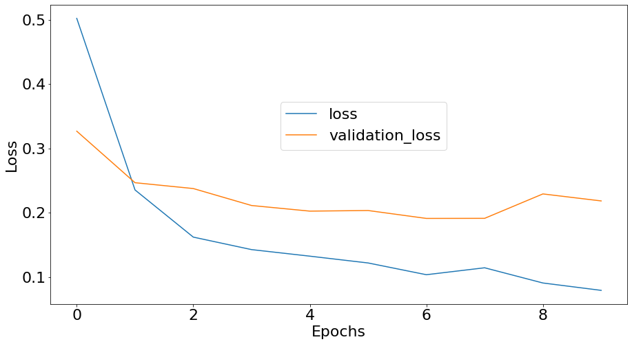
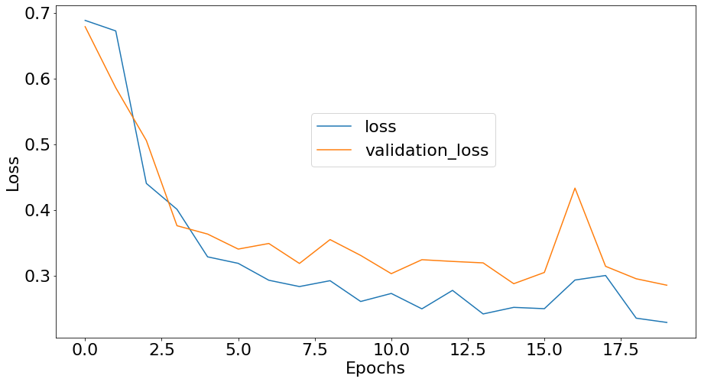
Loss Graphs:
IndicFT + BiLSTM
Fasttext + BiLSTM

Slide 7
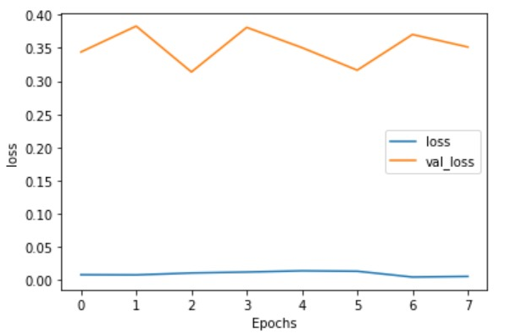
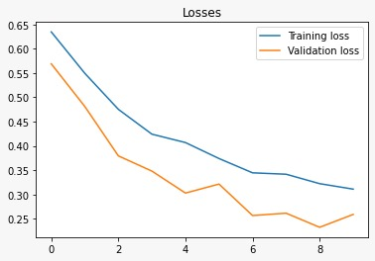
Loss Graphs:
mBERT + BiLSTM
mBERT + CNN

Slide 8
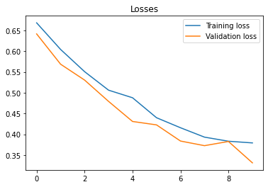
Loss Graphs:
IndicBERT + CNN

Slide 9
Current Hyperparameters used:
Validation split = 0.1
Epochs = 10
Batch size = 64
One hidden layer, number of neurons = 50
Dropout = 0.1
Activation function in hidden layer = relu
Activation function in output layer, = sigmoid, 1 neuron
Loss = binary cross entropy
Optimizer = adam

Slide 10
Agenda for the following week
Train Machine Learning models on the existing dataset.
Fine tune the existing models.
Do further EDA to reduce overfitting.
Telugu to kannada, if dataset exists
Hindi to kannada translation
Augmentation of existing dataset
Back-translation

Slide 11
Proposed workflow for translation:
Find publicly available datasets(if exists)
Work on different methods to translate which includes but does not limit to translation, transliteration, etc
Compare the test/train results with:
Train: Current; Test: Translated
Train: Translated; Test: Current
Log the results and evaluate

Slide 12
PHASE 1
Scraping dataset for fake news
Scraping dataset for real news
Dataset analysis
Visualization of word embeddings
Top n words
Word cloud
Length distribution
Dataset pre-processing
Cleaning
Punctuation cleaning
Word embeddings
Modeling aspect

Slide 13
PHASE 2
Hindi to kannada translation
Telugu to kannada translation
Data augmentation techniques
Data analysis
Data pre-processing
Modeling aspect
Conclusion on how close results of translation and augmentation techniques compared to that of the dataset in original language.

Slide 14
THANK YOU

